Slide 1
Build a Better Student
Build a Better Teacher
Revolutions in Teaching Physics
Chris Meyer
York Mills C. I., Toronto
www.meyercreations.com/physics
Notes:
Thanks for having me here …
It is wonderful to have this opportunity to share with you my story about what I have learned about teaching and physics. I would like to begin by discussing some career advice. What do you do with a physics training?

Slide 2
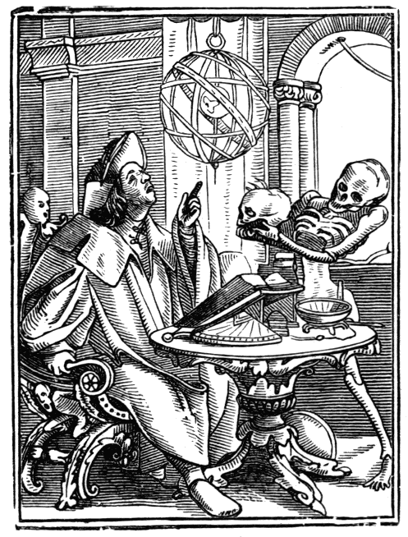
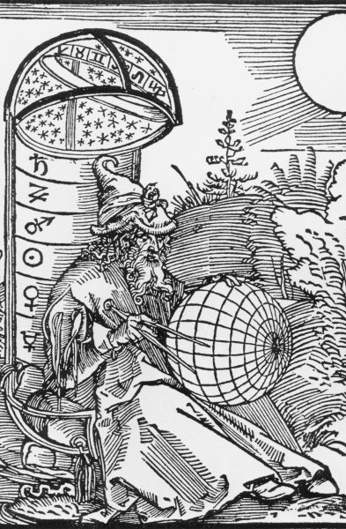
Casting Fortunes
The Dance of Death/Astrologer,
Hans Holbein, 1524
The Astrologer, Albrecht Durer, 1498
Notes:
A person could make a decent buck by their ability to divine the future through the examination of the heavens. Folk would gasp with wonder and marvel at your extraordinary abilities.

Slide 3
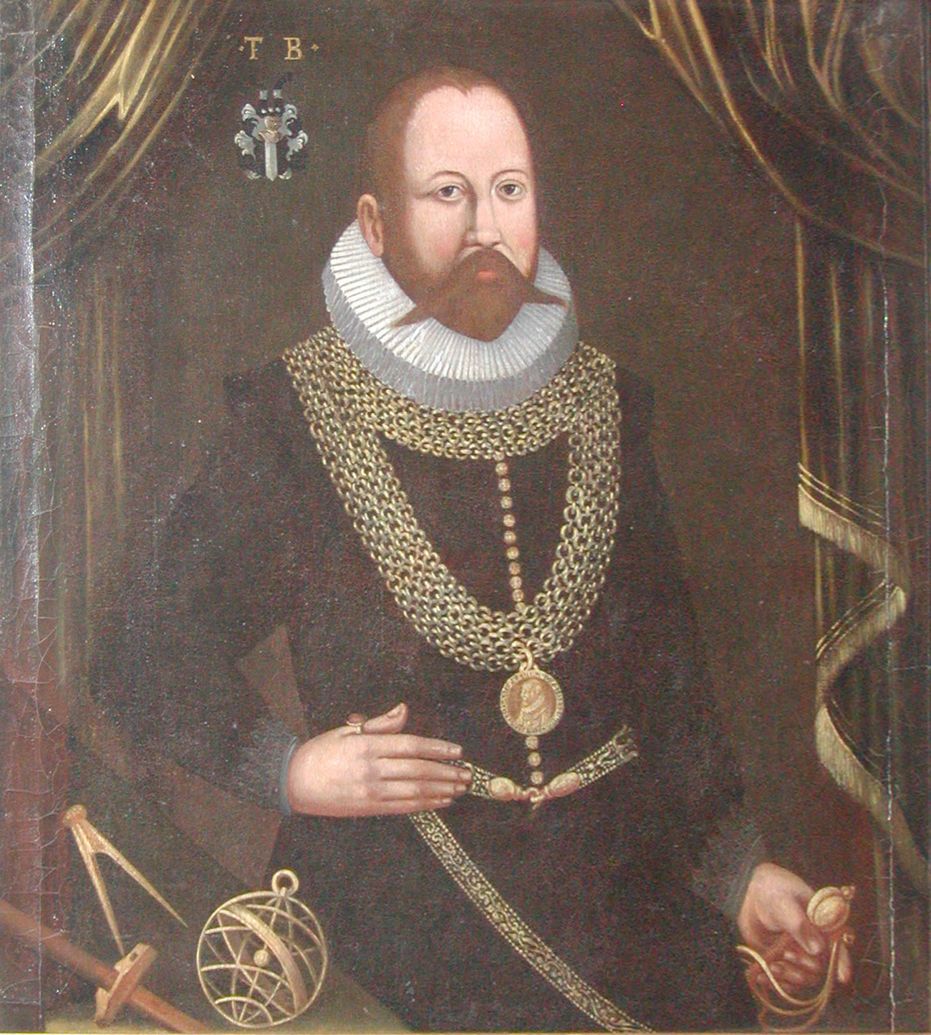
Tycho Brahe
Notes:
These were not all quacks and kooks. This was a learned occupation! Some were great scientific minds.

Slide 4
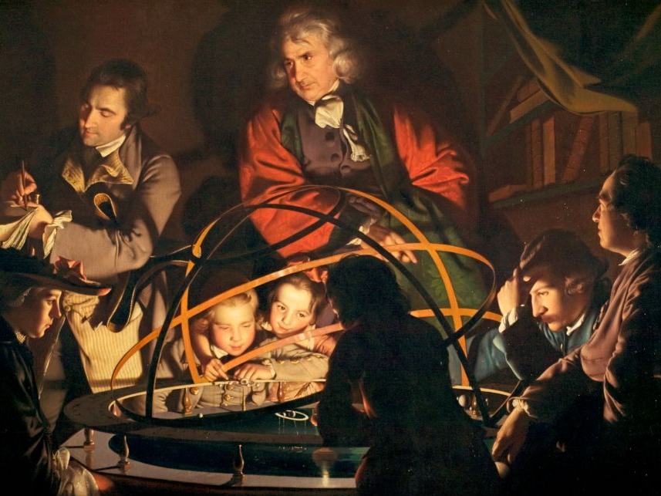
Scientific Revolution
A Philosopher giving a Lecture on the Orrery in which a lamp is put in place of the Sun,
Joseph Wright of Derby, 1766
Notes:
Along came the scientific revolution and put the kibosh on that. The heavens were liberated from superstition! The sobriety of empiricism swept the astrologers out of the academy.

Slide 5
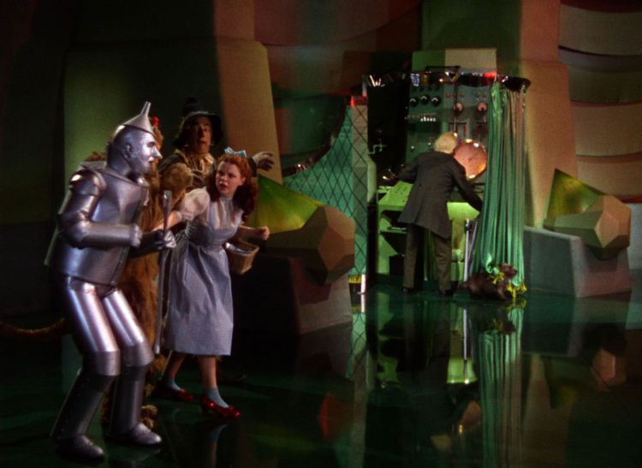
Sobriety of Empiricism
Notes:
When the curtain of magic and wonder was pulled back, the diviner’s powers as much as they were persuasive, were revealed to be illusory. So what to do next with your physics training?

Slide 6
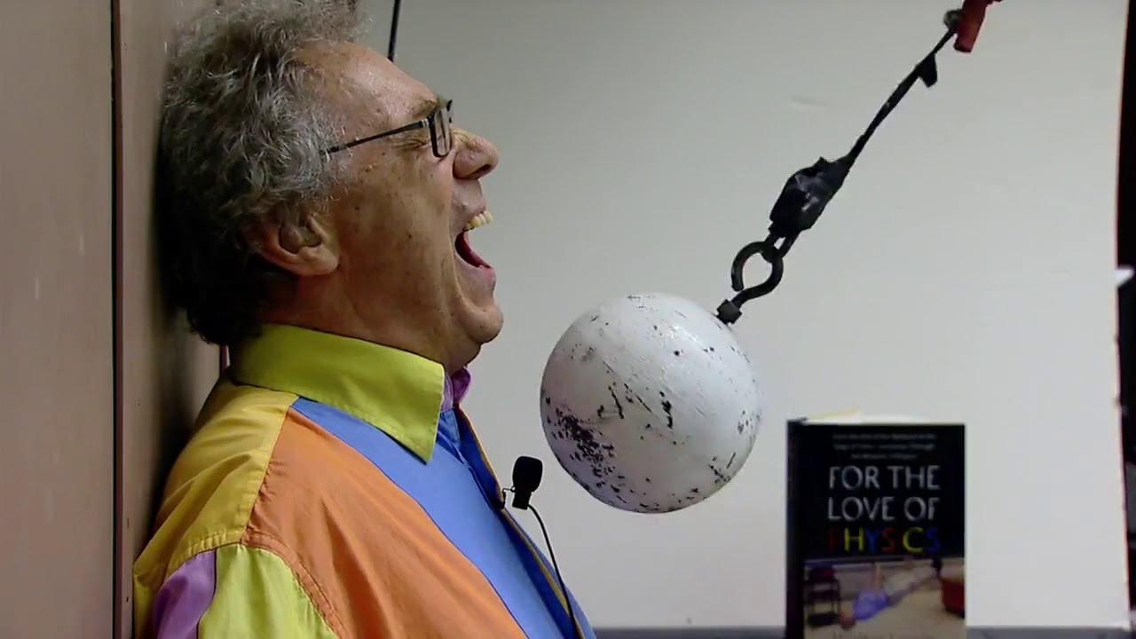
Teaching
Notes:
How about teaching? This is the bread and butter for many of us.

Slide 7
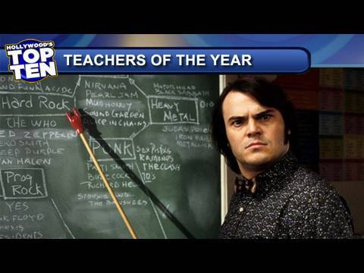
Great Teachers
Notes:
Some teachers also have a mystical ability to spellbind and enthrall. To dazzle and inspire and make a deep emotional connection with people. Some have a great ability to …

Slide 8
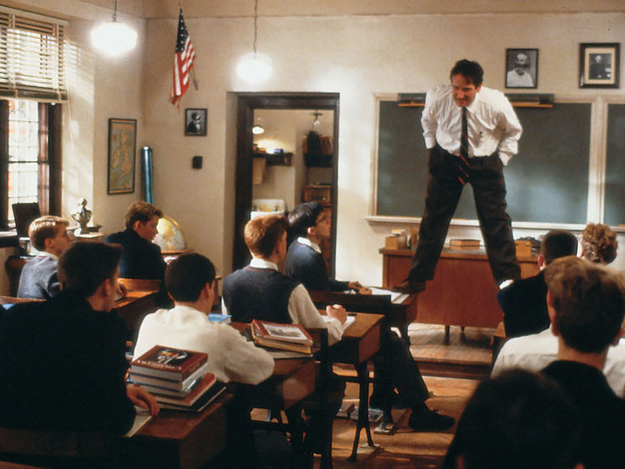
Great Teachers
Notes:
stand on tables. You know someone’s really teaching when …
But wherein lies their power? How far does the power of the charismatic teacher extend?

Slide 9
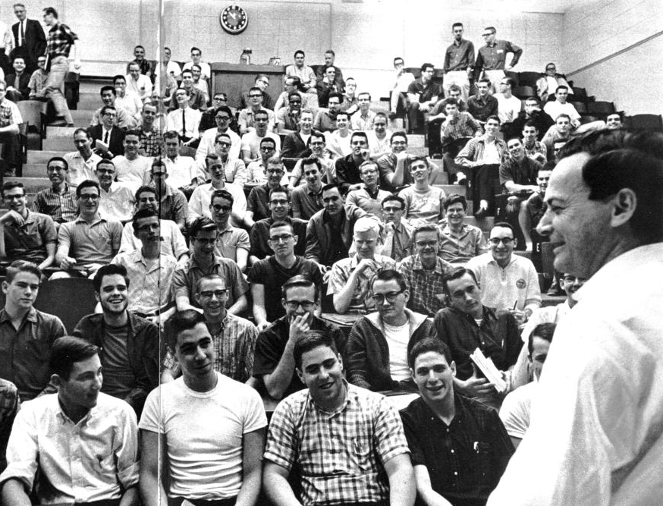
Feynman at Caltech
Notes:
Richard Feynman is widely regarded as having been an extraordinary teacher. His lecture halls at Caltech when he taught introductory physics were packed

Slide 10
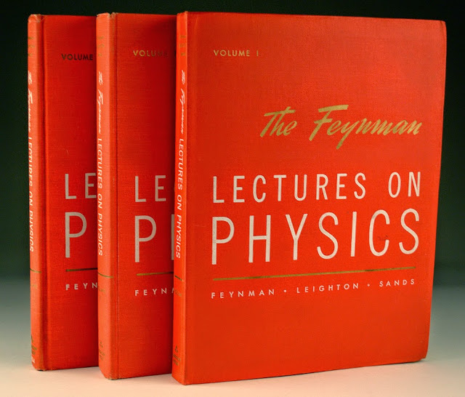
Notes:
and his lectures have become legend. But Feynman was confronted with the limits of his Magical powers. As many of you might well know, reality cuts deepest when reviewing final exam results. He remarked that amongst the many disappointing exam papers:

Slide 11
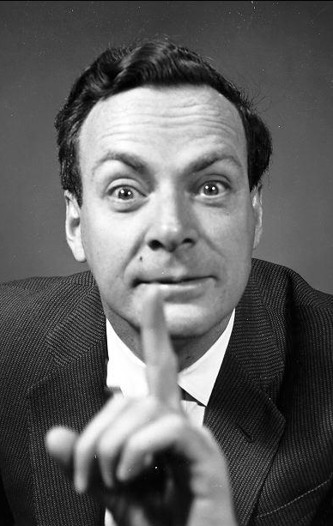
“There were one or two dozen students who – very surprisingly – understood almost everything …

Slide 12
“…These people have now, I believe, a first-rate background in physics – and they are, after all, the ones I was trying to get at.”
Notes:
All was not well, but he took solace. He sensed something was not right, but took a convenient fig leaf to cover his pride. A response that many of us can relate to.

Slide 13
How well is the material presented?
How well are students learning?
Notes:
The great teachers perform extraordinarily well, when judged by the question:
But how well do they perform when we ask a different, more scientific question?

Slide 14
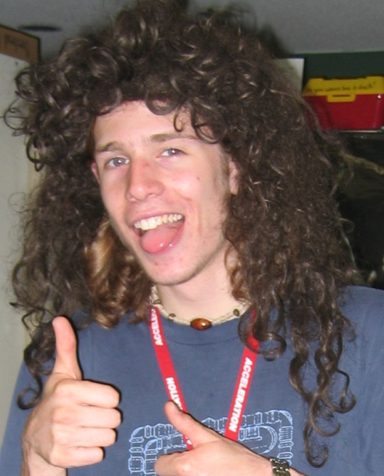
Physics Wisdom
?
Typical Student
Notes:
Let’s take a moment to think about what this question means. Take your typical physics student. When we do our best to share our hard-earned physics wisdom, and the question is: how much makes it in there? How do we figure this out?

Slide 15
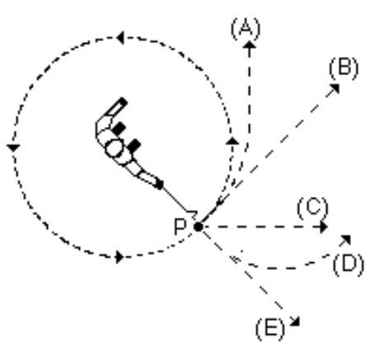
Question Time!
A ball on a string is swung in a horizontal circle.
At point P, the string breaks.
Which path would the ball most closely follow, observed from above?
A
B
C
D
E
Hestenes, D., Wells, M., & Swackhamer, G. (1992). Force concept inventory. The physics teacher, 30(3), 141-158.
Notes:
By creating an empirical test. The Force Concept Inventory …
The hallmark of these questions is that they do not involve any math.

Slide 16
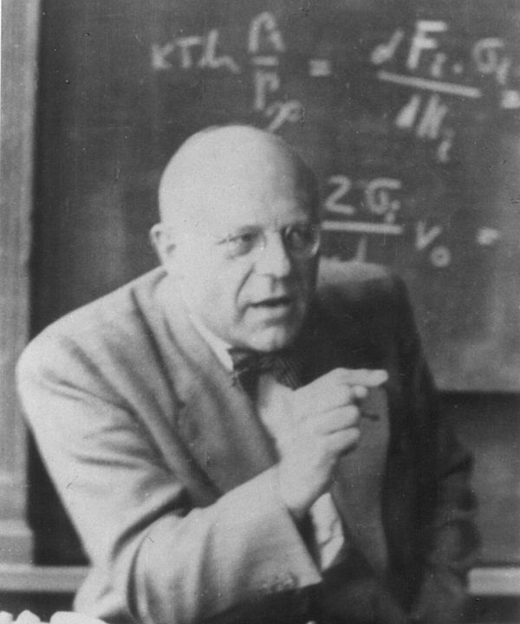
Way too easy!
Harrumph!
Notes:
And if you give them to a cranky expert, they will growl with disdain:
But they provide a revolutionary window into our students understanding and the effectiveness of our instruction.

Slide 17
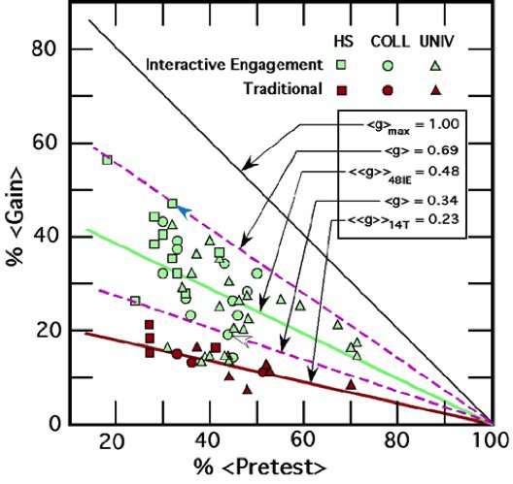
How Much Are Students Learning?
Force Concept Inventory
Traditional Instruction
Normalized Learning Gain
= 23%
Hake, Richard R. "Interactive-engagement versus traditional methods: A six-thousand-student survey of mechanics test data for introductory physics courses." American journal of Physics 66.1 (1998): 64-74.
Notes:
As revealed by a massive meta-study, traditional lecture-based instruction has a distinct cut-off in effectiveness, regardless of the quality of instructor. .... Red shapes ….
Learning gain is a measure of ….

Slide 18
Physics Wisdom
23%
77% Scattered,
lost as heat and
Star Trek trivia
Typical Student
Notes:
So now we have an answer: how much do students improve under the benefit of out wisdom?
And what happens to the rest?

Slide 19


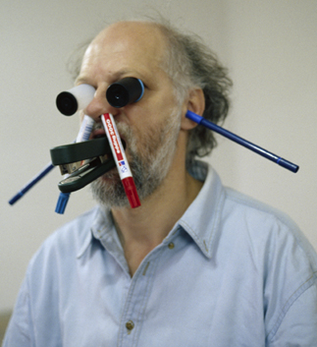
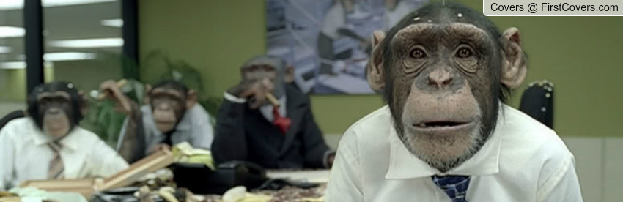
Best Lesson Ever
Notes:
All of us teachers have long sensed that this was the case. We have all had the experience …

Slide 20
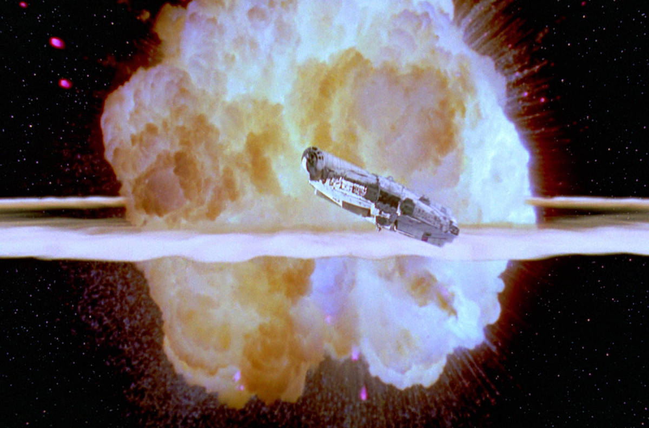
Notes:
And they bomb it in epic style.

Slide 21
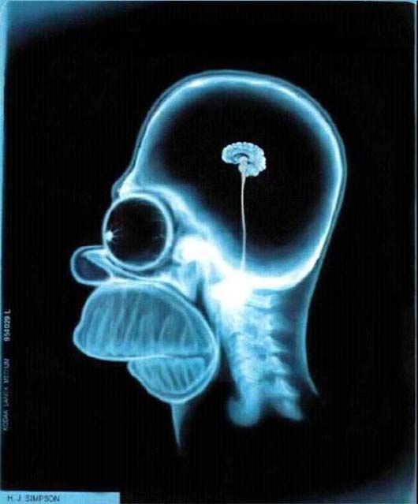
What’s Going on Upstairs?
Notes:
While we are left wondering:
… how did I get stuck teaching this course and when can I get back to my research.

Slide 22
A Scientific Revolution for Teaching
A Philosopher giving a Lecture on the Orrery in which a lamp is put in place of the Sun,
Joseph Wright of Derby, 1766
Notes:
The FCI was part of the early wave of research that began to transform teaching into an empirical science. Almost thirty years later, we are in the midst of a full scientific revolution for teaching. The excitement and great potential of this is what brings me here today. When we harness the powers of science, we can replace our instinctual reactions to our students’ learning difficulties:

Slide 23
WTF?

Slide 24
What’s happening in our brains when we learn?
Notes:
With clear scientific questions to answer.

Slide 25
Research
Model of Learning
Curriculum Development
Instruction
Notes:
The goal of this scientific revolution is to iteratively develop model of learning that informs the development of our teaching curriculum, ….
This is very exciting because physicists are renowned for their modeling …

Slide 26
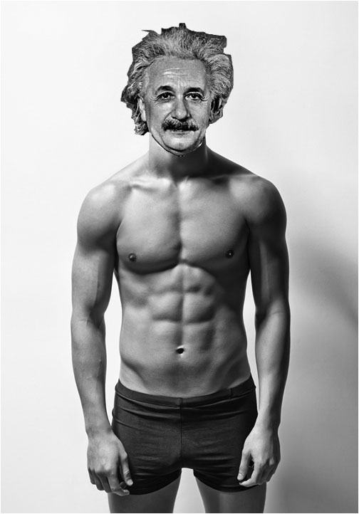


Slide 27
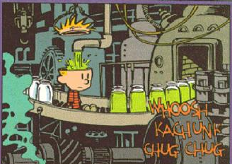
Learning Model #1
Notes:
Here is one very common model for learning….
We just have to figure out the right stuff to poor in, screw on the lid tightly (maybe that was our problem … ) and, voila!

Slide 28
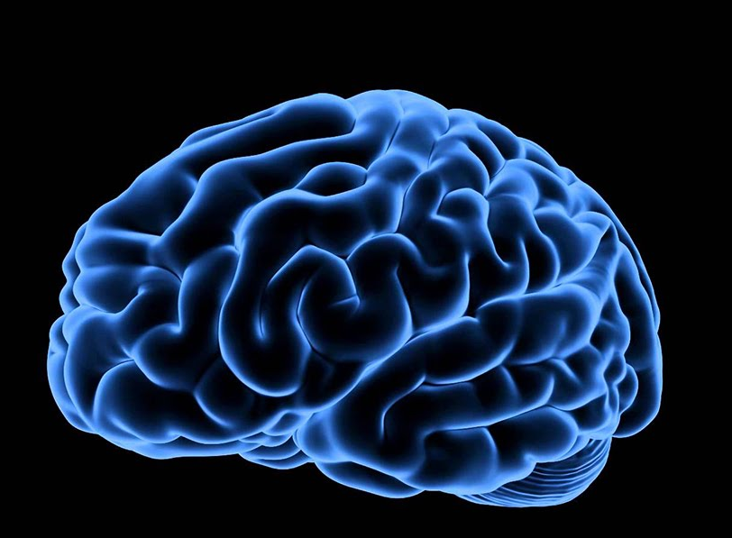
Learning Model #2
Epistemological Resource Framing
Notes:
Here is another model with an awesome name.

Slide 29
Knowledge is built from primitive pieces
Increased resistance = less result
Force moves objects
Stronger influence wins
DiSessa, A. A. (1993). Toward an epistemology of physics. Cognition and instruction, 10(2-3), 105-225.
Notes:
Smallest units of knowledge = “cognitive resources”
- seem true from everyday experience, do not need further explanation, “just the way the world is”

Slide 30
As We Learn Connections Grow
Increased resistance = less result
Force moves objects
Stronger influence wins
Notes:
- As we learn connections grow or become more numerous

Slide 31
Networks of Cognitive Resources Form
Force spins
Force deflects
Heavy things resist
R ↑, motion ↓
Motion dies away
Opposites cancel
F ∴ motion
Change takes time
Stronger wins
Objects squish with force
More effort = more resistance
Notes:
Complex networks form, connecting numerous cognitive resources

Slide 32
Activation Depends on Context
Force spins
Force deflects
Heavy things resist
R ↑, motion ↓
Motion dies away
Opposites cancel
F ∴ motion
Change takes time
Stronger wins
Objects squish with force
More effort = more resistance
Notes:
Complex networks form, connecting numerous cognitive resources

Slide 33
Activation Depends on Context
Force spins
Force deflects
Heavy things resist
R ↑, motion ↓
Motion dies away
Opposites cancel
F ∴ motion
Change takes time
Stronger wins
Objects squish with force
More effort = more resistance
Notes:
When it comes time to recall and make use of an idea, we activate the network of resources. How it is activated depends on many factors including the new context the person is considering.

Slide 34
and on Epistemological Frame
Our brain’s process for filtering our senses and choosing relevant knowledge
this is a force situation
this is an energy situation
search for memorized knowledge from an authority (equations / laws)
search for connections with intuition (physical understanding / experience)
Redish, E. F., & Kuo, E. (2015). Language of physics, language of math: Disciplinary culture and dynamic epistemology. Science & Education, 24(5-6), 561-590.
.
Notes:
A kind of survival mechanism we have developed to deal with the vast information our senses pick up.

Slide 35
Students are Wired
Students arrive in our classes with their brains prewired
based on their personal experiences
and prior schooling.
Notes:
The final piece of this model reminds us that …
This is the opposite of the empty vessel idea …

Slide 36
Research
Model of Learning
Curriculum Development
Testing
Instruction

Slide 37
Mazur’s Discovery
Find the current
through the 2 ohm resistor and the potential difference between point a and b.
75%
Average =
Notes:
A few examples to help us compare the explanatory power of these two models.

Slide 38
Mazur’s Discovery
Explain what happens to the following when the switch is closed:
• the current through the battery
• the brightness of the bulbs
40%
Average =
Notes:
We cover this material …. Why does this happen.

Slide 39
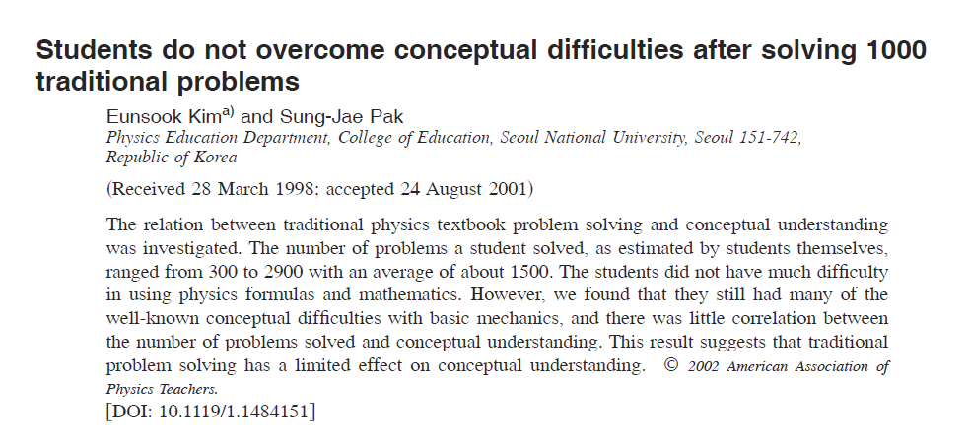
Korean Cram Schools
Kim, Eunsook, and Sung-Jae Pak. "Students do not overcome conceptual difficulties after solving 1000 traditional problems." American Journal of Physics70.7 (2002): 759-765.
Notes:
Students from the famous Korean cram schools know how to use their Physics equations and have considerable mathematical skill, and yet...

Slide 40
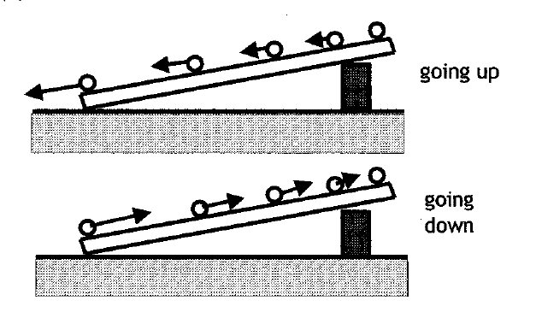
Students Were Asked to Draw Acceleration Vectors for Each Moment in Time
Notes:
Give them a simple question without numbers ...

Slide 41
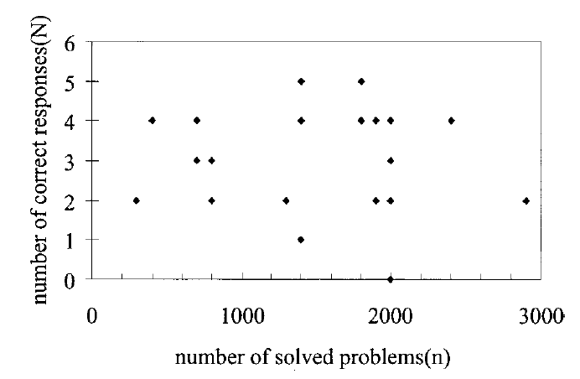
Lots of Practice, Little Understanding
Notes:
We poured in that information. Why is it all tangled up? Perhaps it’s not registering somehow, so we need to get their attention with an awesome …

Slide 42
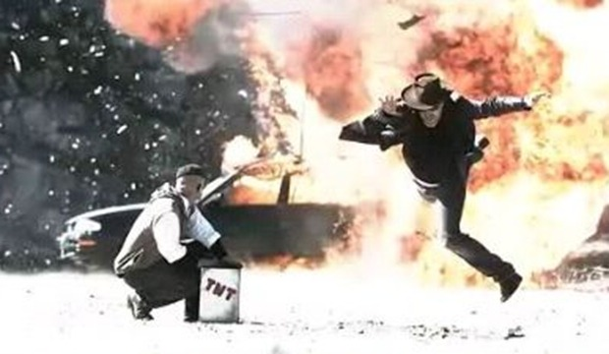
Awesome Demonstrations!
Notes:
We all love these – students remember them for years to come …

Slide 43
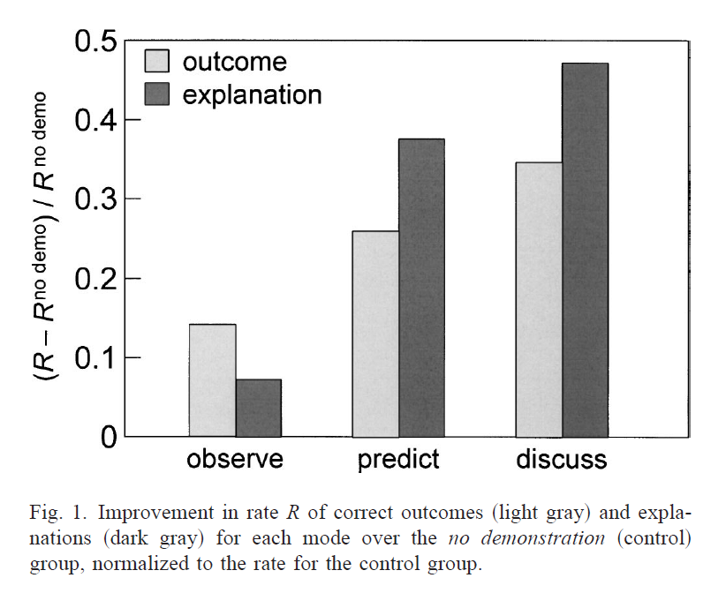
Watching a demonstration only leads to a 15% improvement over doing nothing!
Crouch, Catherine, et al. "Classroom demonstrations: Learning tools or entertainment?." American Journal of Physics 72.6 (2004): 835-838.

Slide 44


People See What They Are Pre-Disposed to Seeing: Epistemological Framing

Slide 45
The Winner
Epistemological Resource Framing
knowledge is built from pieces
it is differentially activated based on context and frame
Notes:
This model does the best job explaining what we observe. The knowledge we present them is not being stored the way we intend, as if they are having difficulty digesting it. In addition, our teaching is competing or conflicting with their prior understanding / wiring. Armed with a plausible theory of learning, where should we begin the task of building a science of teaching?

Slide 46
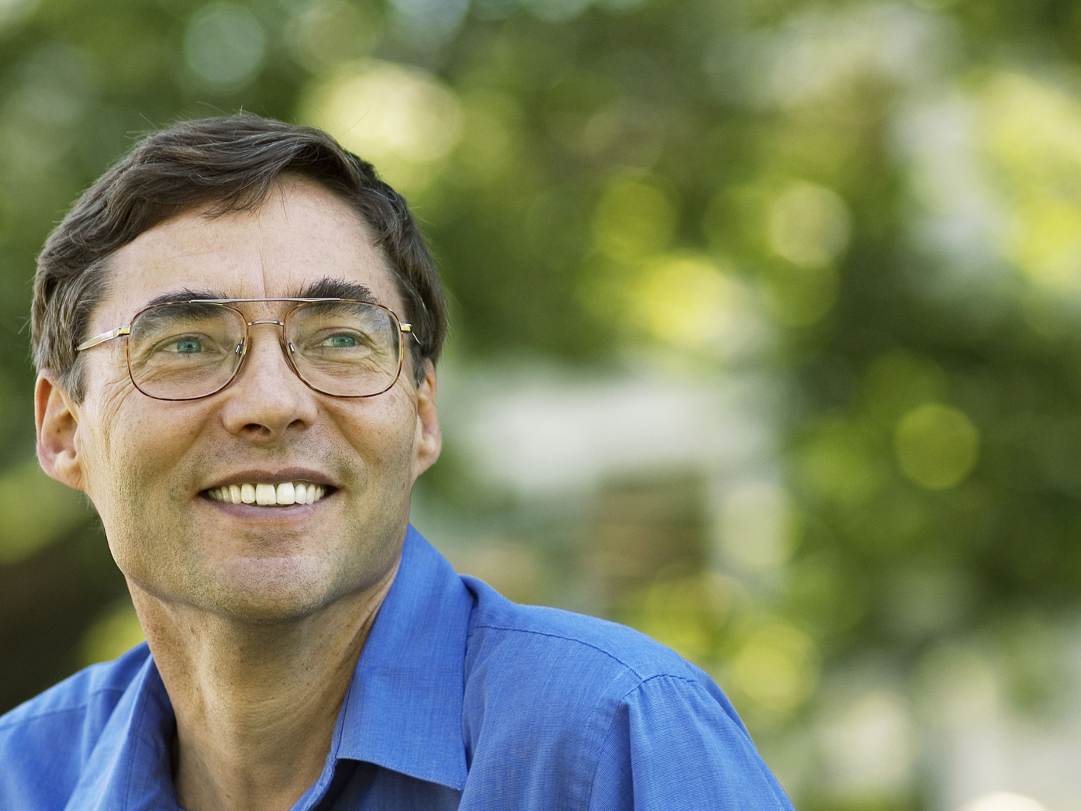
Educational Goal
“to maximize the extent to which the learners develop expertise in the relevant subject, where expertise is defined by what scientists and engineers do.”
Carl Wieman,
Physics Nobel Laureate
Wieman, Carl. "Applying New Research to Improve Science Education."
Issues in Science and Technology 29, no. 1 (Fall 2012).
Notes:
Who is this dashing gentleman? The Nobel prize winning physicist who helped track down the Bose Einstein condensate. For his encore performance he has turned his attention to Physics education and defines his goal for modern science education:

Slide 47
Colorado Learning Attitudes About Science Survey (CLASS)
“When I am solving a physics problem, I try to decide what would be a reasonable value for the answer.”
“I think about the physics I experience in everyday life.”
Pre and post instruction surveys of student attitudes allows us to measure the “shift” in attitudes.
Adams, W. K. et al. (2006). New instrument for measuring student beliefs about physics and learning physics: The Colorado Learning Attitudes about Science Survey. Physical Review Special Topics-Physics Education Research, 2(1), 010101.
Notes:
An important part of expertise is the set of attitudes that physicists have towards the process of learning and doing physics. Researchers have developed told to help us measure the development of expert like attitude in our classroom by asking some simple questions:
If we survey Students at the beginning and end of a course, we can measure how those attitudes change.
The results are even more surprising then the FCI.

Slide 48
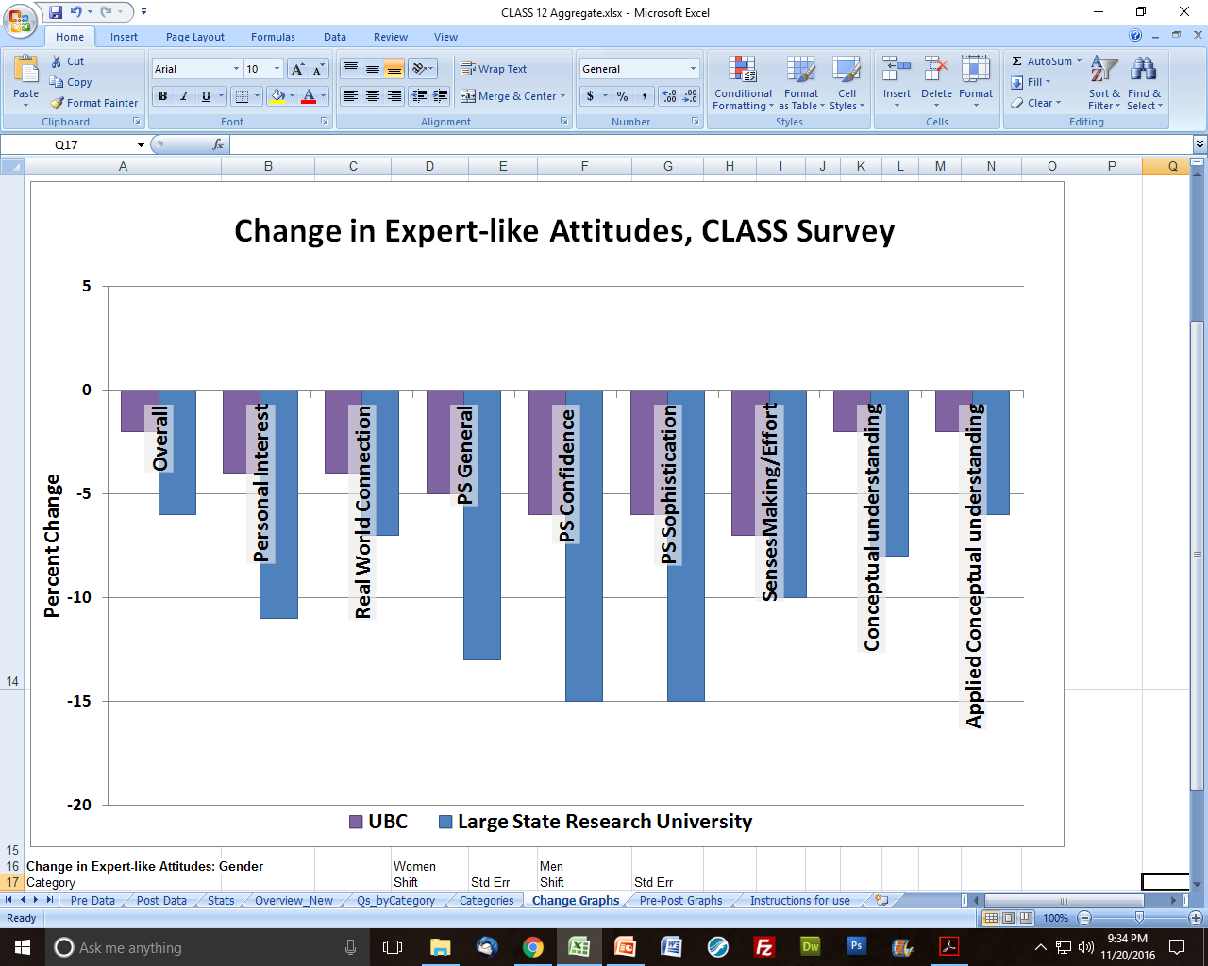
Attitudes About Learning Survey
Milner-Bolotin, M., Antimirova, T., Noack, A., & Petrov, A. (2011). Attitudes about science and conceptual physics learning in university introductory physics courses. Physical Review Special Topics-Physics Education Research, 7(2), 020107.
Notes:
Typical instruction usually causes a significant negative shift in attitudes across a range of attitudes.
Undergrad chair? Take note!

Slide 49

The Novice
Knowledge fragmented
Little context
Force spins
Force deflects
Heavy things resist
R ↑, motion ↓
Motion dies away
Opposites cancel
F → motion
Change takes time
Stronger wins
Objects squish with force
More effort = more resistance
Notes:
So let’s peer into to the novice brain and see what’s happened.
We find fragmented knowledge resources with little connection to context or to ideas that help them decide when the knowledge is useful or relevant. As a result, they tend to grasp at surface features and fail to penetrate to the core ideas.

Slide 50
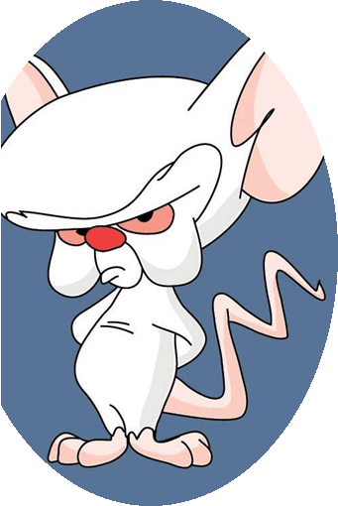
The Expert
Rich connections
Highly contextual
Force spins
Force deflects
Heavy things resist
R ↑, motion ↓
Motion dies away
Opposites cancel
F → motion
Change takes time
Stronger wins
Objects squish with force
More effort = more resistance
Notes:
The expert brain has numerous connections between knowledge resources that are tightly bound to context and conditions of use. Rapidly see deeper ideas at work.

Slide 51
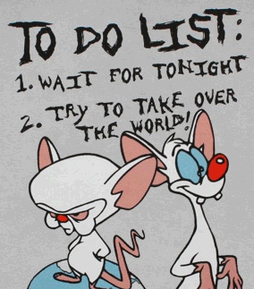
Educational Goal
Notes:
To clarify Wieman’s goal, we want to transform the novice into an expert... And.....

Slide 52
Goal of Instruction: Rewire Student Brains
Force spins
Force deflects
Heavy things resist
R ↑, motion ↓
Motion dies away
Opposites cancel
F → motion
Change takes time
Stronger wins
Objects squish with force
More effort = more resistance
Notes:
At a deeper level, or educational goal translated into wiring – we want to rewire or students brains!

Slide 53
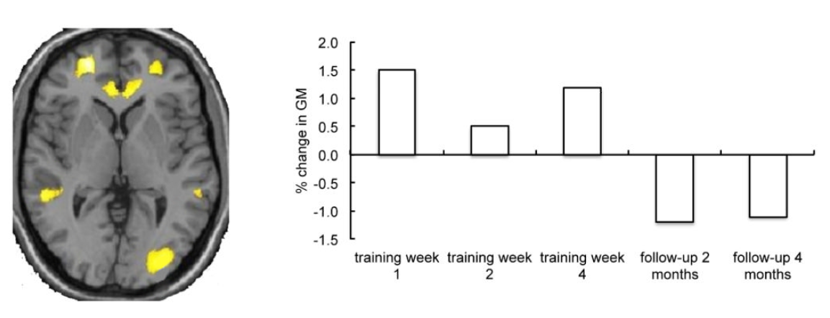
Learning = A Physical Process
Zatorre, R. J., Fields, R. D., & Johansen-Berg, H. (2012). Plasticity in gray and white: neuroimaging changes in brain structure during learning. Nature neuroscience, 15(4), 528-536.
Notes:
This is exciting! Because we now understand that learning is a physical process and not hocus pocus. And who is awesome with physical processes? Recent results from neuroscience have shown some of the first tantalising evidence for the growth of brain tissue in response to learning ... And... The shrinking of tissue as a result of disuse.

Slide 54
Instructional Goal
It’s not how you present the material
It’s the quality of the learning environment you create for your students.
Notes:
Now we can ask the question: “What should our instruction accomplish?” What type of experiences promote the re-wiring our students’ need?

Slide 55
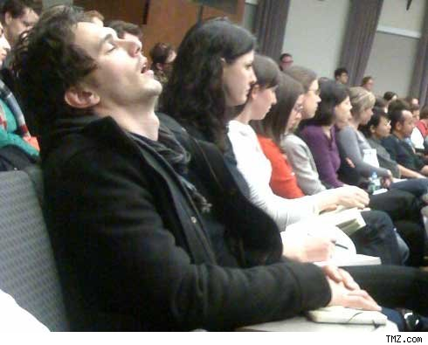
What Doesn’t Promote Learning?
James Franco @ Columbia University
Notes:
We can be pretty sure what doesn’t promote learning.

Slide 56
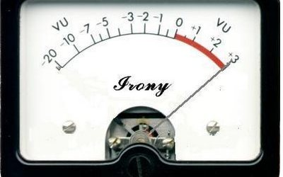
Notes:
Just to clarify: lecture is good as transmitting information, but very poor at promoting deep understanding.

Slide 57
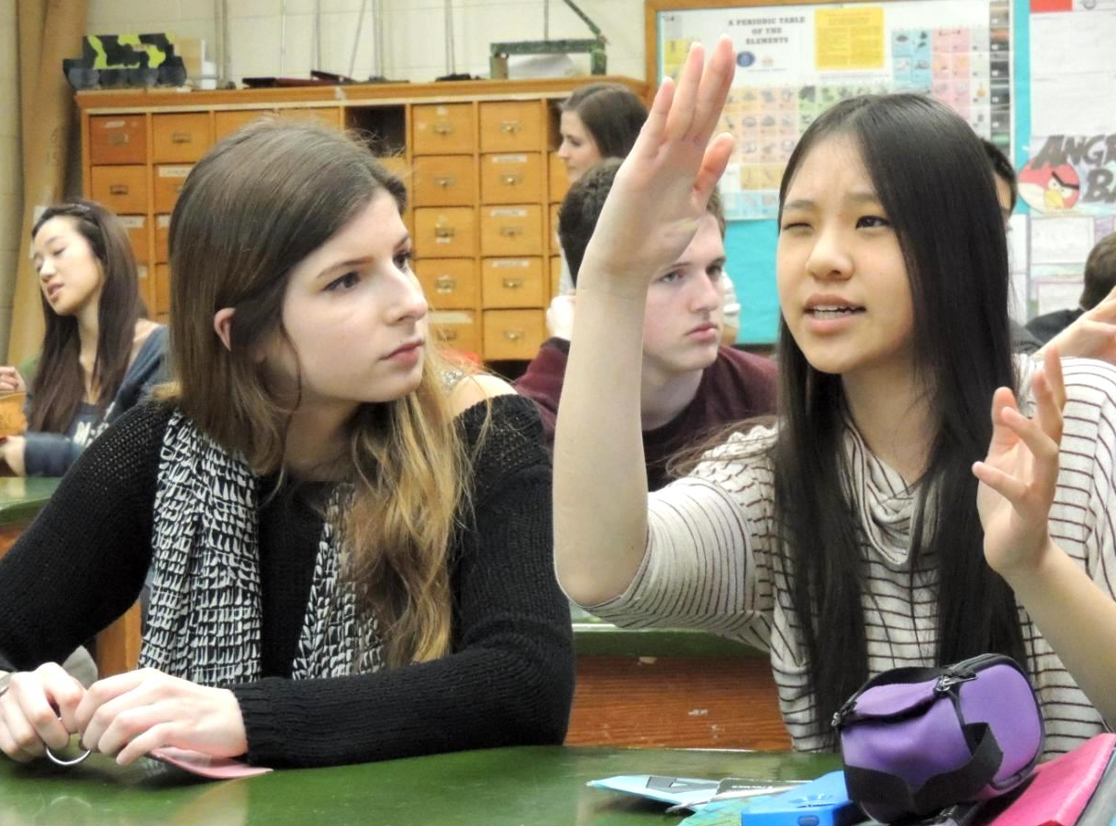
What does? Active Learning

Slide 58
What does? Active Learning
“Active learning engages students in the process of learning through activities and/or discussion in class, as opposed to passively listening to an expert. It emphasizes higher-order thinking and often involves group work.”
Freeman, Scott, et al. "Active learning increases student performance in science, engineering, and mathematics." Proceedings of the National Academy of Sciences (2014): 201319030.
Notes:
This is the game changer!

Slide 59
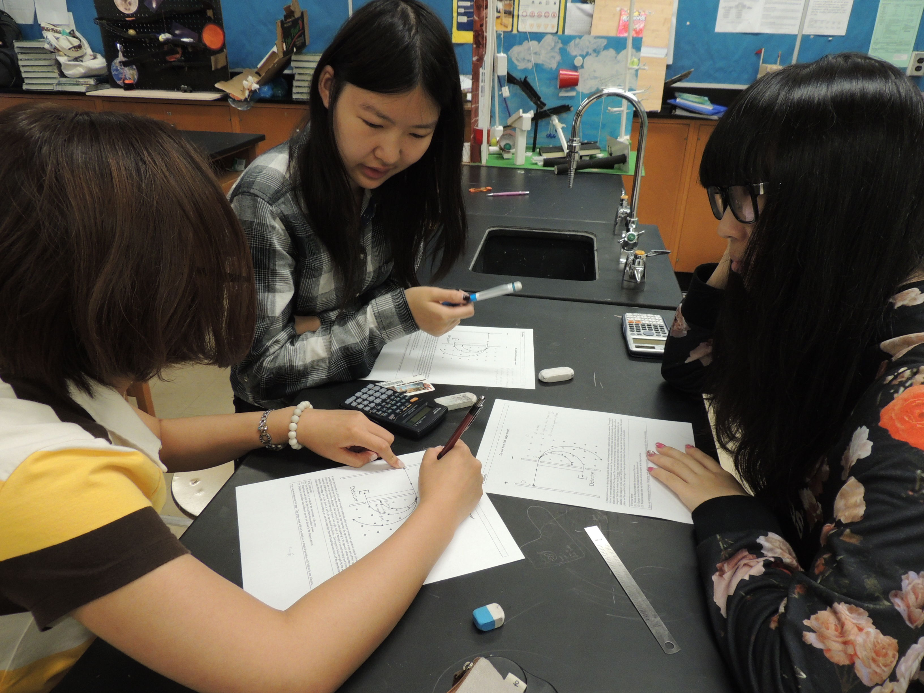
The Social Learning Principle
Humans learn best through social interactions
Redish, E. F. (2003). Teaching Physics with the Physics Suite. Wiley.
Notes:
It is no surprise to the rest of the world, but to physicists it is a shocker …

Slide 60
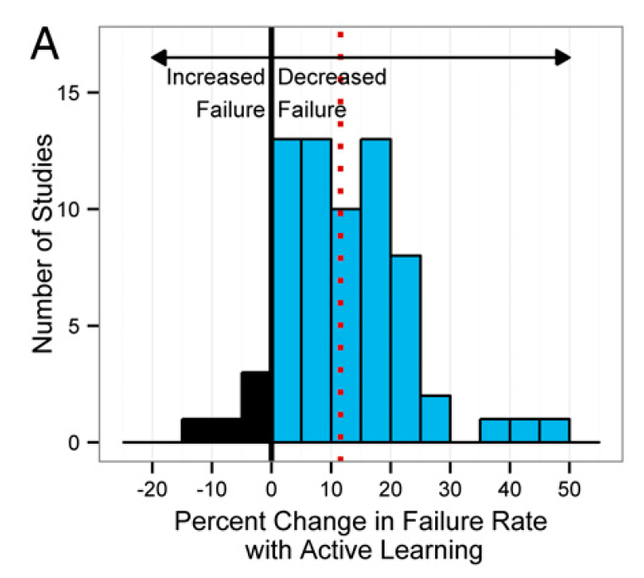
Freeman, Scott, et al. "Active learning increases student performance in science, engineering, and mathematics." Proceedings of the National Academy of Sciences (2014): 201319030.
Notes:
A massive meta-study comparing active learning to traditional instruction across many STEM disciplines shows a significant decrease in the failure rate

Slide 61
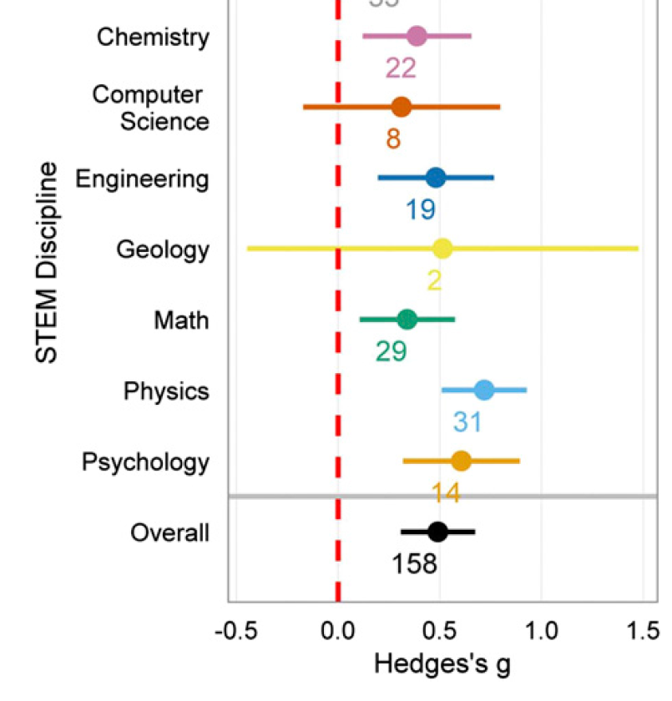
Improved Course Performance
Notes:
A significant increase in performance on exams or conceptual surveys … and hey! Look at physics leading the pack with improvements of ¾ of a standard deviation.

Slide 62
Active Learning Works
Active Learning
Normalized Gain = 48%
Notes:
Now we see the complete picture and the power of active learning. The shapes in green are …
Active learning doubles the improvements our students make due to instruction. Twice as much education for the price of one degree. Incredible!

Slide 63
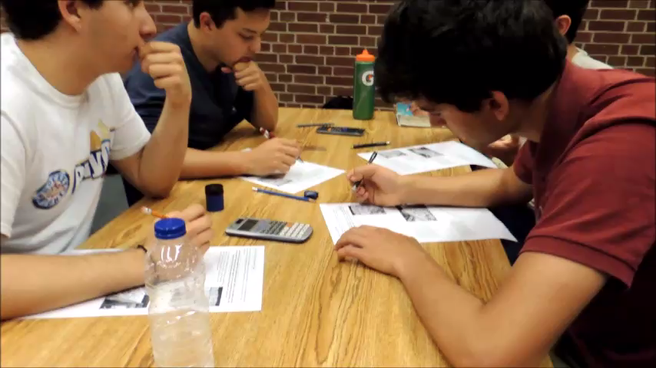
Notes:
Here are some of my students at work. Discuss what you observe and what you infer.

Slide 64
Quality of the Learning Environment
(1) We can’t download our brains to students
(2) Active, discussion-based learning is the most effective
(3) A conceptual focus allows for the deepest connections: Ideas First, Formalism Second, Math Third
Notes:
(1) Our knowledge is not in a useful form, (2) our classes must provide students with time to explore ideas, (3) no matter how mathematically sophisticated physics is, deep concepts and principles govern its operations

Slide 65
Yeah, but …
It worked for me.

Slide 66
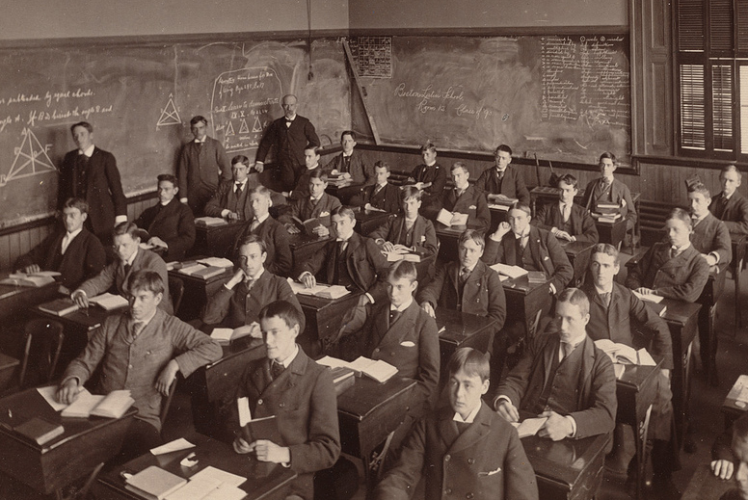
You Thrived in the Traditional Classroom

Slide 67
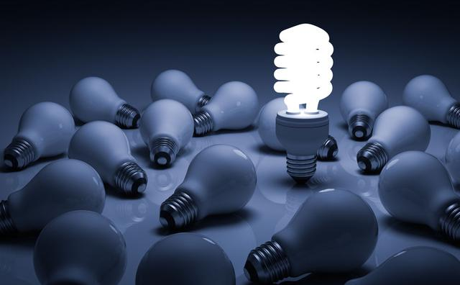
You are not the average student
Physics
Prof

Slide 68
Do not mistake yourself for your students
The fact that it worked for you only proves that it worked for you.
You suffer from expert blindness: You have forgotten what it’s like to be a novice.

Slide 69
Yeah, but …
There is so much material to cover

Slide 70
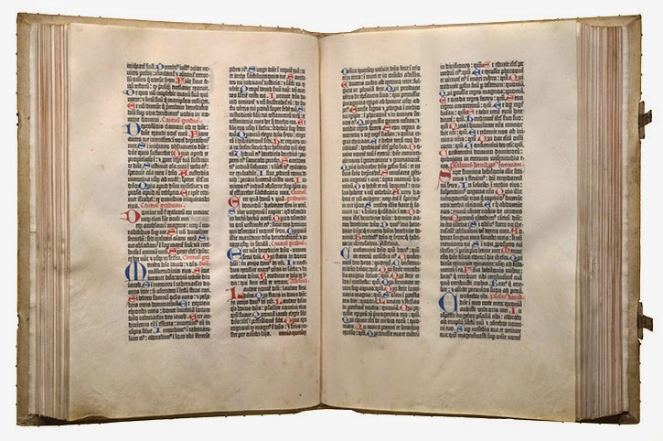
Liberate Yourself From Content
Students can read prior to class
Learning Management System: Perusall.com
Cover less, but do it well
Biblia latina (Bible in Latin). Mainz: Johann Gutenberg, 1455.
Otto Vollbehr Collection, Library of Congress (01.17.00)
Notes:
There is one technology that, more than any other, has the potential to disrupt the educational system and leave it staggering for a clear response. The printed book.

Slide 71
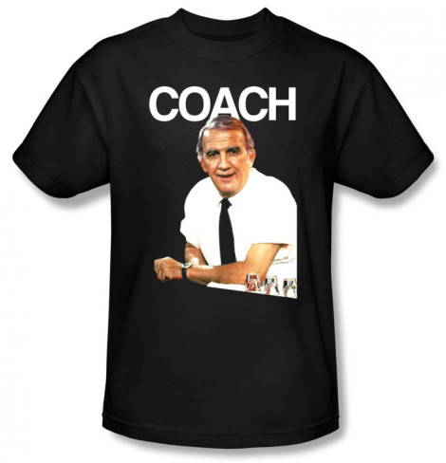
The Role of the Teacher
We help them sort through the details.
We provide context, insight and meaningful practice.
Notes:
Instead of being a purveyor of content, you can take up a much more meaningful role …

Slide 72
Yeah, but …
I don’t have time to change everything
Notes:
Don’t. Start with something small and manageable. With that in mind, I have …

Slide 73
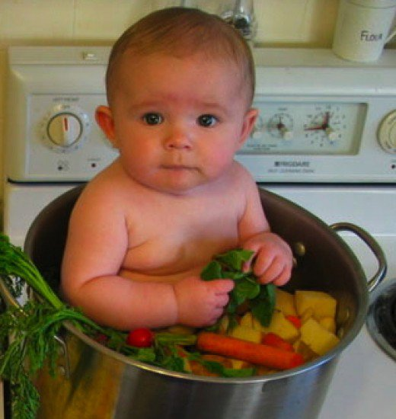
A 100% Satire-Free Modest Proposal
PHYSICS 4L03 A/B - Literature Review
A directed reading and review of the literature in any field of physics or astronomy, associated with a faculty member’s research area.

Slide 74
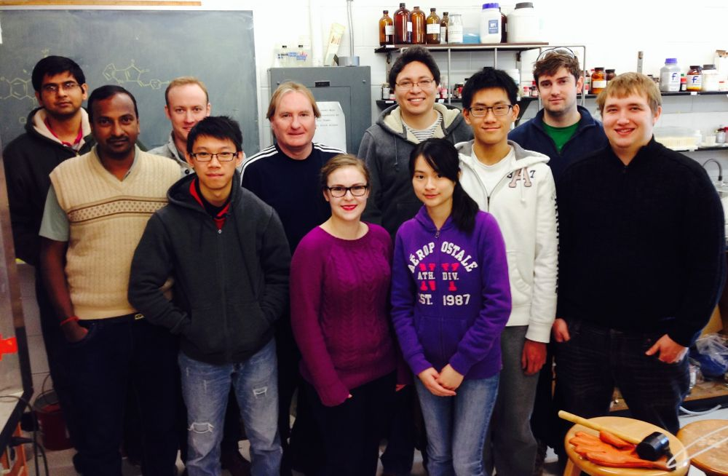
Win-Win Deal
You need help / time
Upper-year undergrads and graduate students need apprenticeship in teaching
Use PHYSICS 4L03 A/B to:
Summarize relevant literature
Observe classes / interview students
Study problem set / exam results
Design lesson ideas for trial

Slide 75
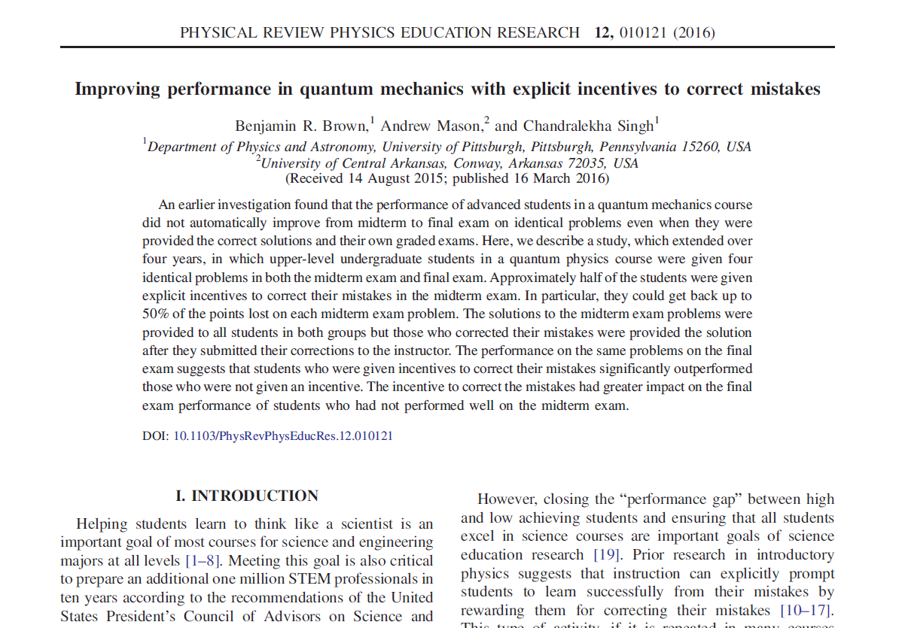
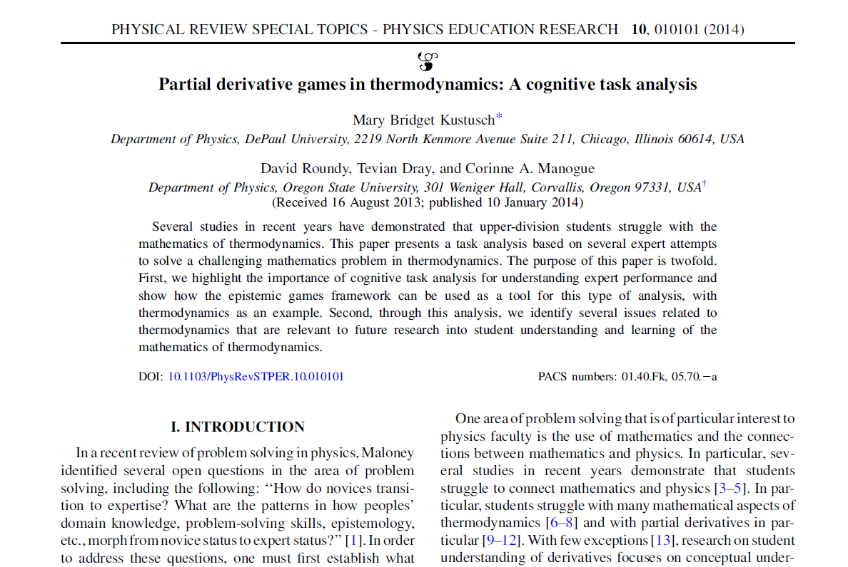
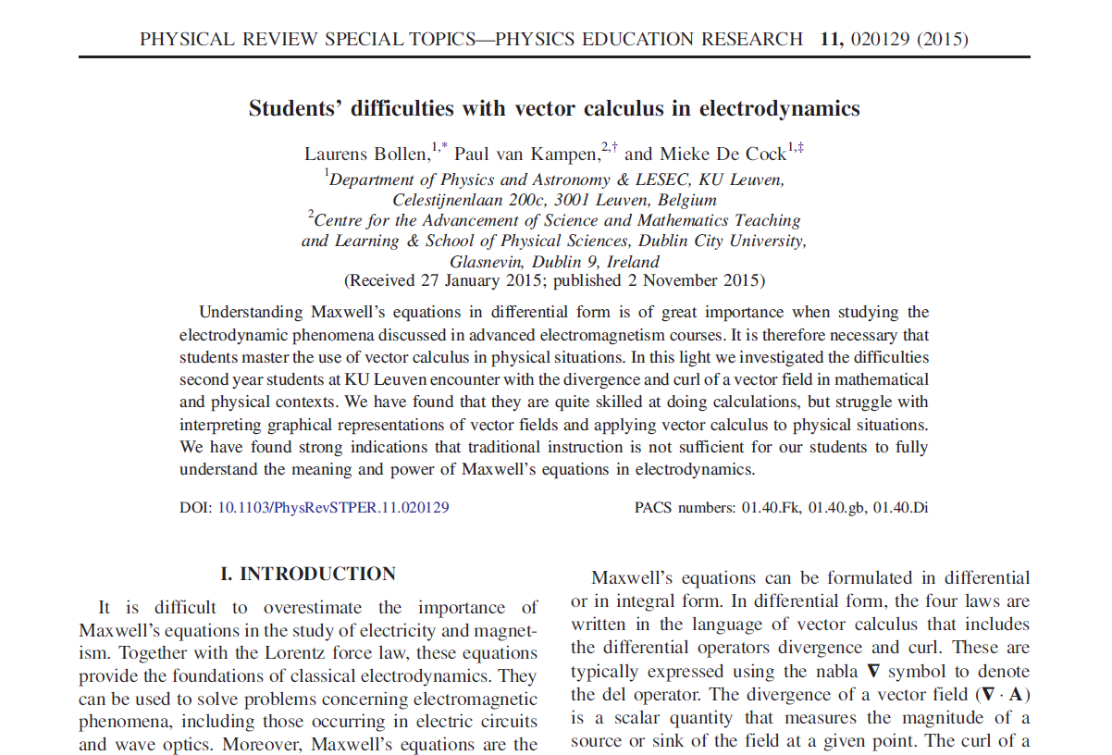
PER Covers All Standard Undergrad Topics

Slide 76
The Health of the Physics Community

Slide 77
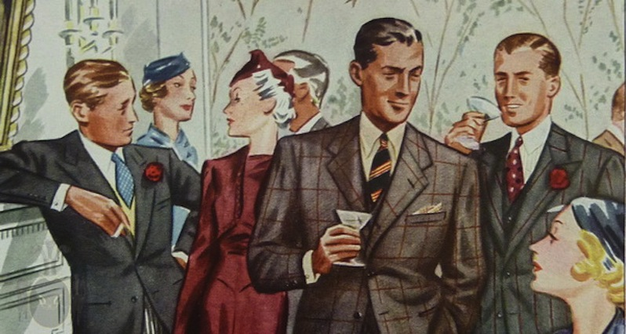
The Cocktail Party
Wow, physics, eh?
Physics was my worst subject.
Oh, I liked physics in school. But I didn’t do very well.
Notes:
You have probably had conversations like these:
And they look at you like a strange, other-worldly creature, largely because physics has an enduring reputation for:

Slide 78
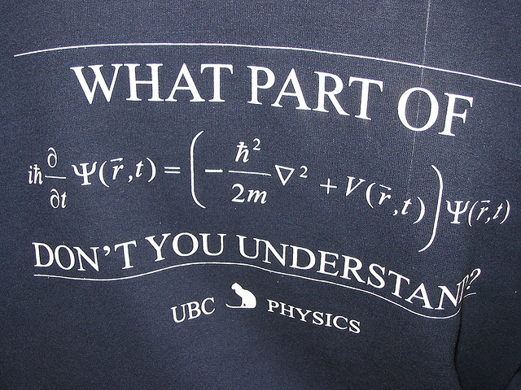
Physics is Hard
Notes:
Being hard.

Slide 79

The Physics Community in 1927
What kind of people can do physics?
Notes:
This reputation and other factors has led people to construct a very narrow view of the strange and magical “people who can do physics”.

Slide 80

Notes:
We can see how powerful this effect is and the stunning lack of diversity it brings to this profession.

Slide 81


The Social Contract of Teaching
An Allegory of the Revolution (1794),
Nicolas Henri Jeaurat de Bertry
Notes:
You might not recall signing this contract, but it exists and the legalese goes something like this:

Slide 82

Teach Our Kids Well
Notes:
The public asks that we:

Slide 83

Do Your Crazy Science Stuff
Notes:
And in return, you can do your crazy science stuff that no one understands.
While you might disagree with this notion, it does not make it go away. And we neglect it at our peril.

Slide 84

Disgruntled People Will Make Decisions About Our Life’s Work
Notes:
We just need another government unfavourable to academic research …

Slide 85
Build a Better Student
Build a Better Teacher
Revolutions in Teaching Physics
Notes:
With a scientific approach to teaching and learning, we can literally …

Slide 86

Build a Better Teacher
York Mills Mean = 81.5% ± 0.7%
Toronto High School = 73%
Ottawa High School = 79%
Average PreMed student starting Harvard
= 70%
Average student with gr. 12 physics starting U of T
= 57%
Average student with gr. 12 physics starting Ryerson
= 39%
Notes:
By creating a well-designed, research-informed program, average teachers can produce results that our best teachers a generation ago could only dream of.

Slide 87

Build a Better Student
Notes:
Reformed teaching can help students develop expert-like attitudes towards learning and …

Slide 88

Build a Better Student
Notes:
Encourage under-represented communities of people to appreciate the majesty of the physical universe and the rewards of the physics profession.

Slide 89
The Magic of Experts
High level of training
Anders Ericsson, K., Roring, R. W., & Nandagopal, K. (2007). Giftedness and evidence for reproducibly superior performance: An account based on the expert performance framework. High Ability Studies, 18(1), 3-56.

Slide 90

My Prediction
Physics education will improve to the point that any adult of average intelligence can be trained to become a well-regarded, expert physicist.
Arabic Astronomers, 1513

Slide 91
Join the Scientific Revolution for Teaching
Thanks!
www.meyercreations.com/physics
Notes:
I encourage you to join the …
with the hope that this will help start a new chapter in your teaching careers and also provide well-deserved bragging rights, so that you might tell your great-grandchildren, who will take this way of learning for granted, that you were part of the great teaching revolution of the first half of the 21st century.

